Slide 1
Dr. Sau Kamaltai Gawai Institute of Engineering And Technology, Darapur
“ARRYTHMI MONITORING SYSTEM FOR WOMEN SECURITY”
Guided by:- Prof. A.W. Kale
Presenting by :-
1.Chaitalee A. Ghurde
2.Shivani U. Raipure
3.Shital B. Bhongle
4.Arti V. Sangole

Slide 2
Contents
INTRODUCTION
LITERATURE REVIEW
BLOCK DIAGRAM
Components description
flowchart
ADVANTAGES
application
Future scope
conclusion
REFERENCES

Slide 3
INTRODUCTION
As we all know that India is a most famous country all over the world for its great tradition and culture where women are given most respected place in the society from the ancient time.
Safety of women matters a lot whether at home, outside the home or working place. Last few crimes against women especially rape cases were very dread and fearful. Because of such crimes, women safety in India has become a doubtful topic.

Slide 4
This system suggests a new perspective to use technology to protect women. The system resembles a normal watch is used for to measure the heart beat when heart beat is arrthmy.
The various modules such as GSM shield (SIM), Arduino, heart beat sensors for measuring the heart beat rate. heart beat sensors is mounted on a watch.
The pocket device consisting of GPS and GSM module and microcontroller to track the location and send the notification.

Slide 5
Literature review
Sr.no. | Title of Paper | Name of Author | Year of publication | Conlusion
1 | Heart rate monitoring for women and child safety | Prof:-Dongare Uma,Vyavahare Vishakha and Raut Ravina. | 2018 | By using the heart beat sensor the arrythemi is measured and it will increased sent to a pocket device.
2 | A SMART SECURITY WATCH FOR WOMEN | Prof:- Archana Naik. | 2018 | Women safety, the system has use the pressure sensor and emergency switch with change in motion sent the notification to the emergency contacts.
3 | SMART GIRLS SECURITY SYSTEM | Prof:-Thooyavan V. | 2014 | She conclude that ,the system connect with the pre-set contact using the GPS & GSM it track the location and send the message.

Slide 6
Sr. No. | Title of Paper | Name of Author | Year of publication | Conlusion
4. | Smart Girls Security System | Prof:-Warren, A.K | April 2014 | This system can overcome every problem women in country about her sefty and security.
5. | A Cost Effective GPS-GPRS Based Woman Tracking System | Thomson, S., Hillman, K | April 2014 | The combination of GPS & GPRS provides real time tracking.

Slide 7
Block diagram
Mini arduino
OLED DISPLAY
Fig:-Block Diagram of Watch Section
SWITCH
REAL TIME CLOCK
Bluetooth Transmitter
HEART BEAT SENSOR

Slide 8
BLUETOOTH RECEIVER
ARDUINO
ATMEGA
328
GSM
BUZZER
GPS
Fig:-Block diagram of pocket section

Slide 9
Component used
OLED display
Aurduino board
Heartbeat sensor
GSM Module
7805 IC
RTC

Slide 10
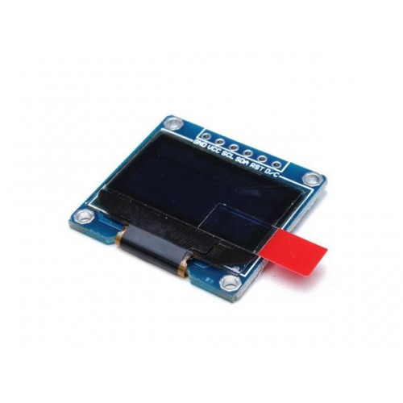
OLED display
OLED Driver IC: SSD1306
Resolution: 128 x 64
Input Voltage: 3.3V ~ 6V
Compatible I/O Level: 3.3V, 5V
Mini Size: 2.7 x 2.8cm
Only Need 2 I/O Port to Control
Working temperature: -30°C ~ 70°C
Module volume ( generous ): 27.0 x 27.0 x 4.1mm
Interface: I2C

Slide 11
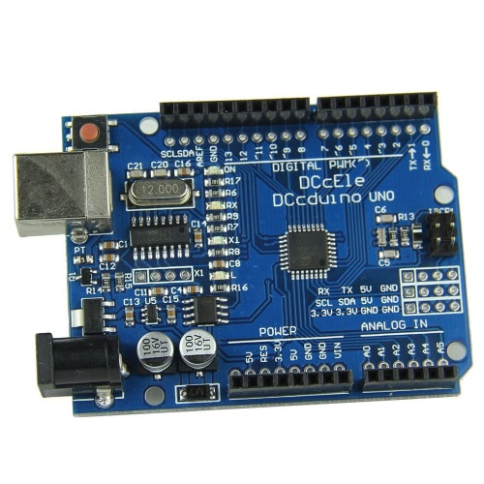
Aurduino Board
The Aurduino UNO is a microcontroller board based on the ATmega328
It has 14 digital input output pins.
Operating voltage is 5V
Flash memory 32Kb (ATmega328)
Clock speed 16 MHz.

Slide 12
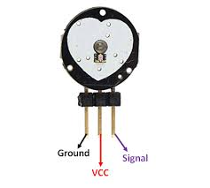
Heartbeat Sensor
Heart beat sensor is an electronic used to measure the heart rate i.e. speed of the heartbeat.
Work as a digital heart rate monitor.
Working voltage of +5 V DC.

Slide 13
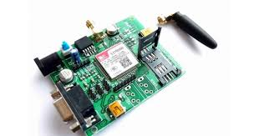
GSM Module
GSM module is used to establish communication between a computer and a GSM-GPRS system.
GSM is an open and digital cellular technology used for transmitting mobile voice and data services
Uplink frequency range specified for 933-960 MHz. and downlink frequency band 890-915 MHz.

Slide 14
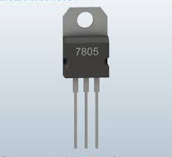
7805 IC
7805 is a linear voltage regulator IC with a fixed output voltage 5 V .
Current rating Ic is 1A
Input voltage range 7V - 35V

Slide 15
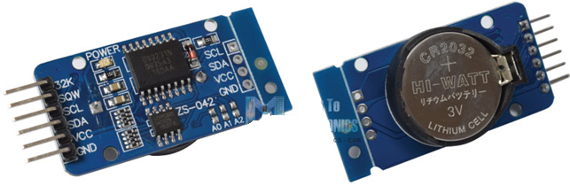
RTC
Highly Accurate RTC Completely Manages All Timekeeping Functions.
Real-Time Clock Counts Seconds, Minutes, Hours, Date of the Month, Month, Day of the Week, and Year, with Leap-Year Compensation Valid Up to 2100.
Programmable Square-Wave Output Signal.
Simple Serial Interface Connects to Most Microcontrollers.
Fast (400kHz) I2C Interface.
Low Power Operation Extends Battery-Backup Run Time.
3.3V Operating voltage.

Slide 16
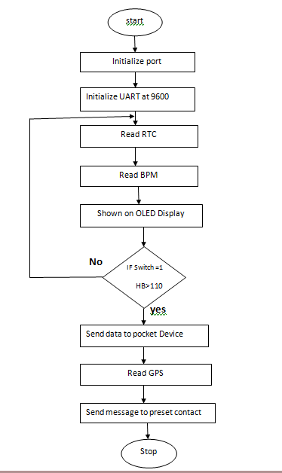
FLOWCHART

Slide 17
ADVANTAGES
Increased self confidence.
It send the heart beat range.
Monitors all hazards and threats.
Alert message to mobile phone for remote information.
Mobile number can be changed at any time.
Can be used to prevent incidents.

Slide 18
APPLICATION
It can be used as an inexpensive alternative to Smart Watches and other expensive Heart Rate Monitors.
Safety for women.
Used as a legal evidence of crime with exact location information for prosecution.

Slide 19
FUTURE SCOPE
Primary School Children Safety: As the school children safety are major concerns for parents as well as school management due to the recent incidents of child crimes like children missing, abuse etc. This module monitors the child safety when they are travelling in school buses. Once they reached the school the device gets deactivated by school authority and message send the parents that, the child reaches the school safely.
Vehicle Safety System Module: The Safety of four wheeler car is also a major concern in the society due to the increase in the crime rate of stolen car. The intrusion detection module can be modified according to the requirement of vehicle safety system module.

Slide 20
CONCLUSION
A low cost and a high security system for the women’s using the GPS, GSM and Heartbeat sensors have been designed. The heartbeat sensors are mainly used for sensing the heart rate. The message can be sent over long distance via GSM in case of emergency or injury. The GPS tracks the location of the person. Hence a wearable technology with high security for women is implemented and designed.

Slide 21
References
[1] ROGER S. Pressman “Software Engineering: A Practitioner's Approach”, SEVENTH EDITION McGraw-Hill International edition 2010, Page No.1-888
[2] Muggah, r. and k. krause (2009), “closing the gap Between Peace operations and Post-conflict insecurity: towards a Violence reduction agenda”, International Peacekeeping, Vol. 16, no. 1, pp.136-150.
[3] Rathmell, a. (2009), “Security and Justice development – what next?”, Journal of Security Sector Management, Vol. 7, p no. 2.

Slide 22
[4] Charlotte Bunch and Roxanna Carillo, “Global Violence against Women: The Challenge to Human Rights and Development” in Michael Klare and Yogesh Chandrani (eds.), World Security: Challenges for a New Century, third edition (New York: St. Martin’s Press, 1998), p. 230.
[5] Beth Woroniuk, "Women’s Empowerment in the context of Human Security", Bangkok, Thailand, December 7-8 1999.

